Slide 1
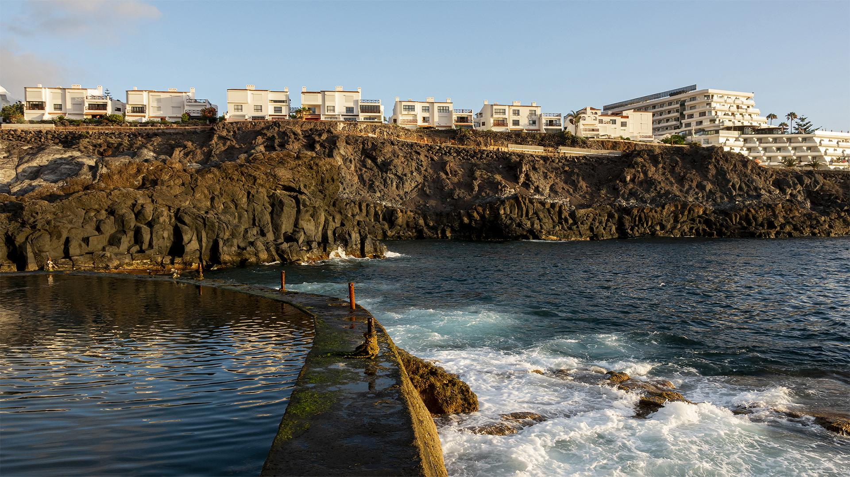
Hotel Review (NLP)

Slide 2
TABLE OF CONTENTS
INTRODUCTION
PREPROCESSING
TOPIC MODELING
MODELS
CONCLUSION

Slide 3
Introduction
Client reviews are a crucial part of improving hotels and customers experience and travel plan.
Customers reviews plays an important part for hotel improvement and in order to improve their services.
The purpose is to build a NLP model that predicts whether the review is positive or negative.
The goal of this project is to help hotels acknowledge the majority of reviews and determine their customers feedback to improve hotel services and customers experience.

Slide 4






Tools
Jupyter Notebook
Pandas
Sklearn
WordCloud
NLTK
Pickle

Slide 5
Data Preprocessing
·1·
·2·
·3·
EDA
Feature Engineering
Tokenization
NLTK (Whitespace)
·4·
Lemmatization
NLTK (WordNet)

Slide 6
DATASET
Scraped data from Booking.com
More than 500k hotel reviews
50000 Sample using pickle

Slide 7
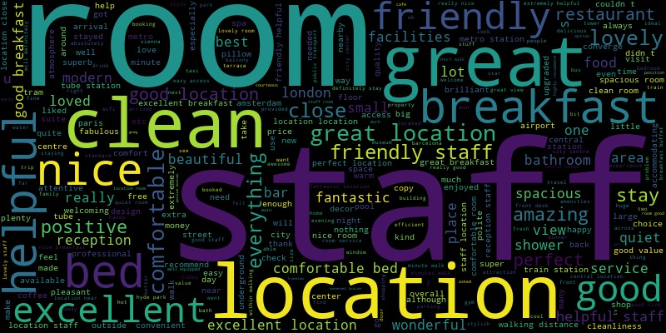
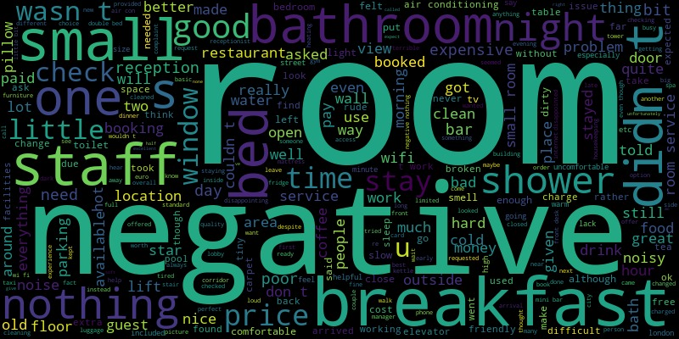
WordCloud
Positive Reviews
Negative Reviews

Slide 8
Topic modeling
Topic 1
NMF (Positive)
Topic 2
Topic 3
Topic 4
Staff
Room
Location
Transportation
staff, friendly, helpful, excellent, lovely, reception, extremely, amazing, polite, nice, welcoming, pleasant, restaurant, fantastic, bar, attentive, perfect, professional, super, facility
room, comfortable, clean, bed, nice, excellent, lovely, spacious, quiet, bathroom, modern, view, size, big, shower, station, close, large, facility, perfect
location, excellent, perfect, central, fantastic, facility, convenient, comfort, value, station, cleanliness, nice, close, price, near, amazing, ideal, best, tube
positive, think, attitude, ended, relocating, helpful, nice, excellent, actually, cleanliness, reception, point, experience, doomed, regina, classy, porter, busicuts, environment, brittania

Slide 9
Topic modeling
Topic 1
LSA (Positive)
Topic 2
Topic-3
Staff
Room
Location
room, staff, location, helpful, clean, nice, comfortable, excellent, bed, lovely
location, room, station, perfect, close, central, walk, excellent, near, tube
room, bed, comfortable, clean, nice, bathroom, spacious, view, big, small

Slide 10
Topic modeling
Topic 1
CorEx (Positive and Negative)
Topic 2
Topic 3
Location
Room
Facilities
station, close, walk, metro, walking, tube, distance, near, walking distance, easy
room, comfortable, lean, bed, rooms, spacious, positive, bathroom, nice, staff
bar, coffee, tea, reception, water, restaurant, pool, complimentary, park, arrival

Slide 11
HOTEL CHAIN
Data Split
60%
20%
20%
Train
Test
Validation

Slide 12
HOTEL CHAIN
Models
 | Train | Validation
Logistic Regression (CV) | 0.966 | 0.9263
Naïve Bayes (CV) | 0.8897 | 0.8735
Decision Tree (CV) | 0.9943 | 0.8716
Logistic Regression (TF-IDF) | 0.9503 | 0.9398
Naïve Bayes (TF-IDF) | 0.8860 | 0.8723
Decision Tree (TF-IDF) | 0.9931 | 0.8844

Slide 13
Conclusions
The best model is Logistic Regression (TF-IDF).
Highest validation accuracy (0.9398).

Slide 14
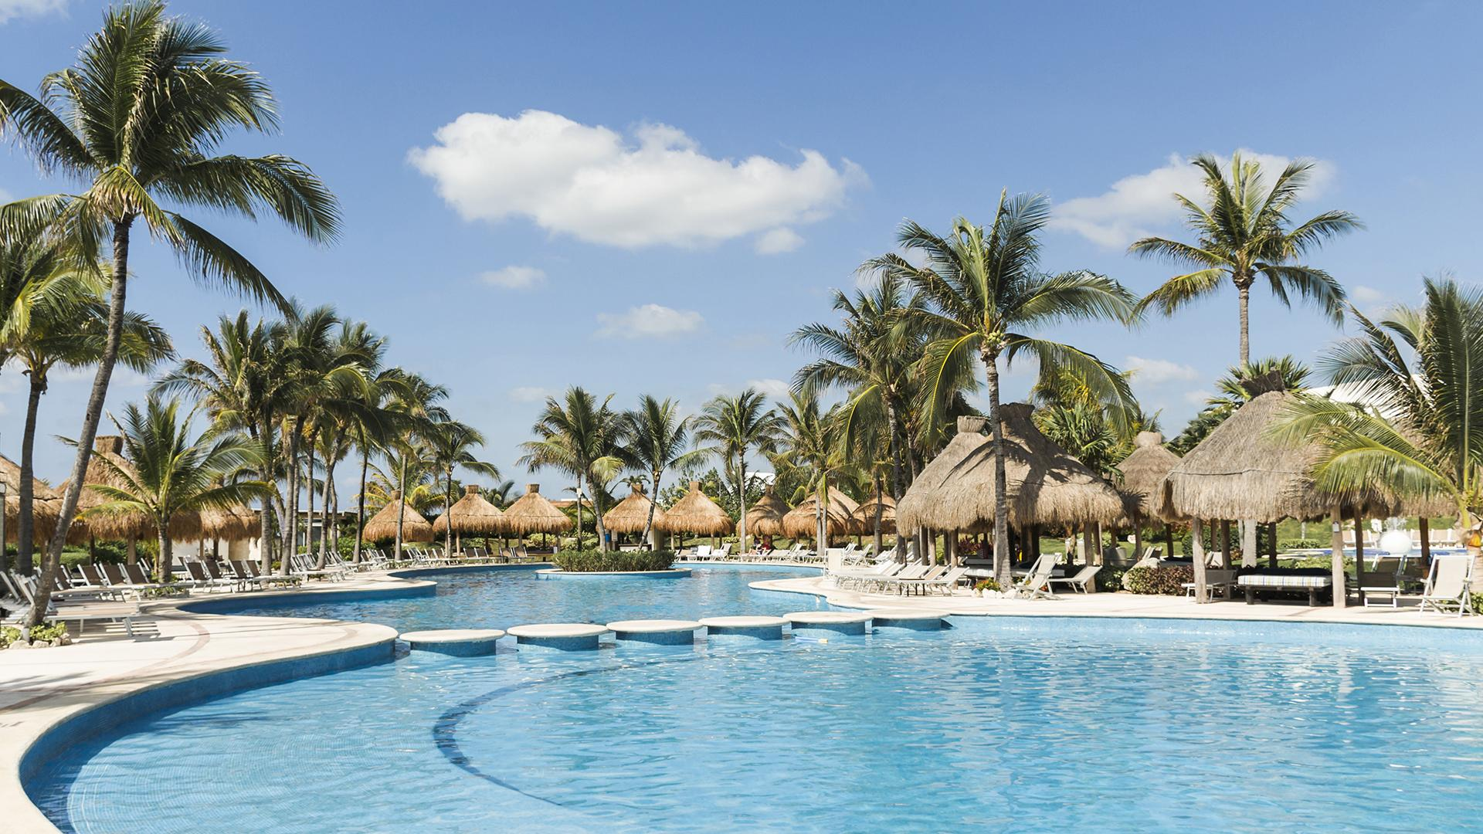
Thanks

